Slide 1
Machine Learning
Workshop
Arielle Blum
Xucheng You

Slide 2
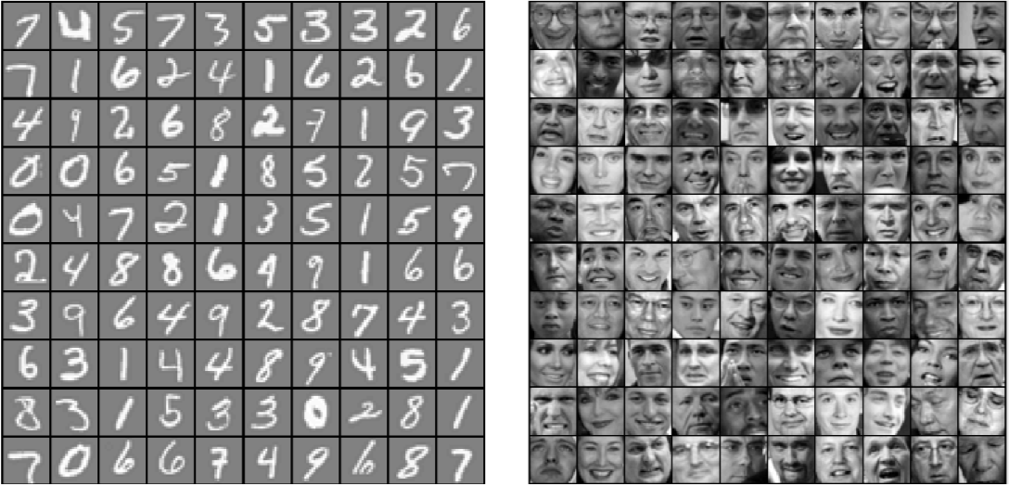
What is Machine Learning?
Ex. Handwritten number and face recognition

Slide 3
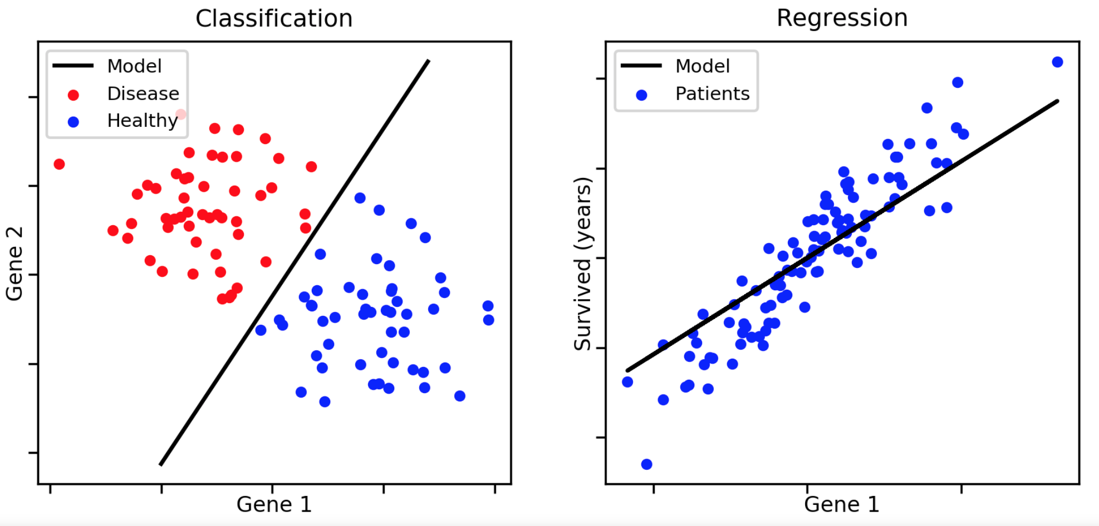
What is Machine Learning?
Ex. Finding how gene and disease are related to each other

Slide 4
How to Install MatLab & Pull Code from GitHub
1. MATLAB R2017b download & license
https://cuservices.colorado.edu/sitelicenses/download/MATLAB_student.html
2. Sample code download
https://github.com/XcYou/Gradient-Descent-Anime
https://github.com/XcYou/ML_Workshop_1
or use terminal and type in the following code:
git clone https://github.com/XcYou/Gradient-Descent-Anime

Slide 5
Linear Regression - Theory Equations
Hypothesis: h_{𝜽}(x) = 𝜽₀ + 𝜽₁x (Simplest linear equation)
Looking for 𝜽₀, 𝜽₁ values to get a line that fits the dataset best.
𝜽₀ is parameter for 0th order term and 𝜽₁ is for first order term (imagine intercept and slope for a straight line...)

Slide 6
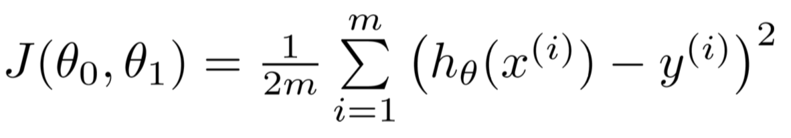
Theory Equations - Cost
Use J(𝜽₀, 𝜽₁) to represent cost function.
y: real data points’ values
h(x): predicted values
m: number of points
J: calculated average error between prediction and real ones

Slide 7
Data Processing before running algorithm
Feature Normalize/ Feature scaling

Slide 8
Feature Normalize
Standard deviation: The Standard Deviation is a measure of how spread out numbers are.
Mean: Average of all terms.

Slide 9
Feature Normalize
1. For each feature dimension, compute the mean of the feature and subtract it from the dataset, storing the mean value in a new array. (Use ‘mean’ function.)
2. Compute the standard deviation of each feature and divide each feature by its standard deviation, storing the standard deviation in a new array. (Use ‘std function’)
Note: For a ‘m x n’ data array, the new array size should be 1 x n.

Slide 10
Gradient Descent - Theory
Goal: To get minimum value of J(𝜽₀, 𝜽₁) and 𝜽₀, 𝜽₁ at that point.
Approach:
1. Start with some 𝜽₀, 𝜽₁
2. Calculate J(𝜽₀, 𝜽₁) and update 𝜽₀, 𝜽₁ to reduce J(𝜽₀, 𝜽₁).
3. J(𝜽₀, 𝜽₁) finally converges or diverges (diverge might be caused by picking wrong parameter values).

Slide 11
Gradient Descent - Theory
Converge: Approaching a limit more and more closely as a variable of the function increases or decreases
Diverge: The opposite of converge. “The infinite sequence of the partial sums of the series does not have a finite limit.”

Slide 12
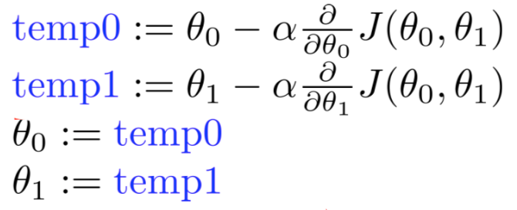
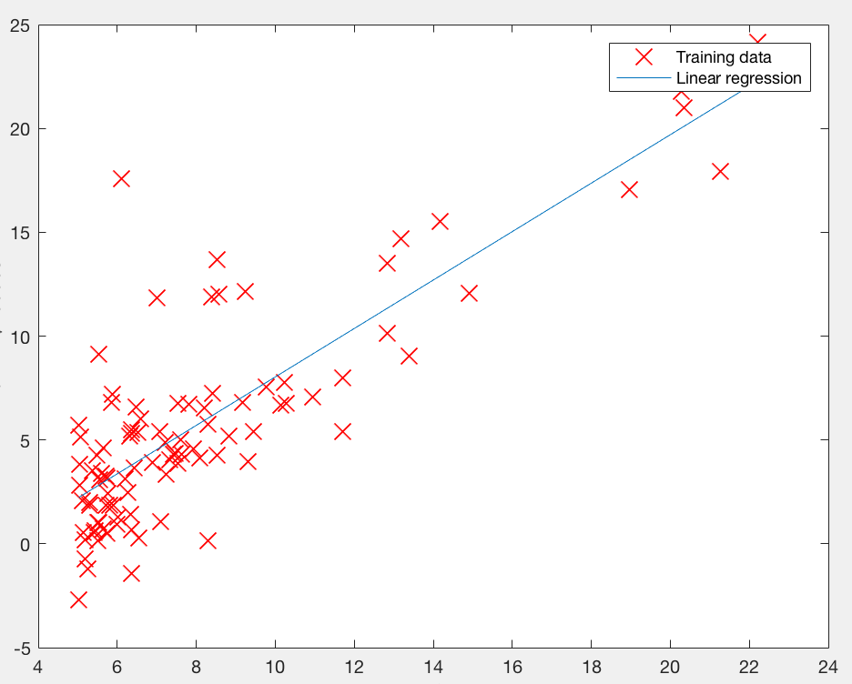
Explaining MatLab - Linear Regression
Code: simultaneous update 𝜽₀, 𝜽₁
Plot line using final 𝜽₀and 𝜽₁ :
for iter = 1:num_iters
% Instructions: Perform a single gradient step on the parameter vector theta.
phi = theta;
theta(1)= (theta(1)-alpha.*sum(X*phi-y)/m);
theta(2)= theta(2)-alpha.*sum((X*phi-y).*X(:,2))/m;
% Save the cost J in every iteration
J_history(iter) = computeCost(X, y, theta);
end

Slide 13
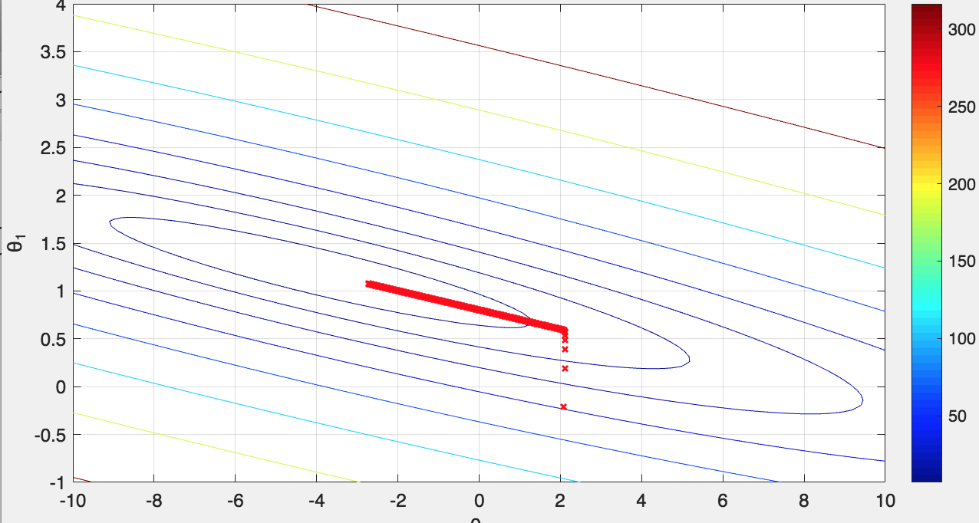
Explaining the MatLab - Code & Cost Animation
How does the contour plot show cost function results?
Ex. contour(theta0_vals, theta1_vals, J_vals, logspace(-2, 3, 20))
𝜽₀=2
𝜽₁=-1

Slide 14
Free-time Guided Play with Animation
- 10 to 15 min
Change __learning rate alfa__ parameter and report the impact
Change __iteration__ parameter and report the impact
Please think about how theta0 and theta1 affect the contour plot.

Slide 15

Other approach for 𝜽₀, 𝜽₁
Normal Equation:
No feature scaling
No loop until convergence

Slide 16
Normal Equation Result:
Same plot as using gradient descent.
𝜽₀= -3.63
𝜽₁ = 1.17

Slide 17
Thank You

Slide 18
MatLab Pre-Processing
Matlab data importing, which function to use

Slide 19
If (something that we don’t have them change, how do you expect this will impact the output? - Explain and discuss in workshop
Show simulation that proves hypothesis (5min)

Slide 20
TensorFlow - Where we are in Beta (5min)

